Slide 1
Event Sourcing and CQRS
“by the book”

Slide 2
Event Sourcing
Event Sourcing defines an approach where all the changes that are made to an object or entity, are stored as a sequence of immutable events to an event store, as opposed to storing just the current state.

Slide 3
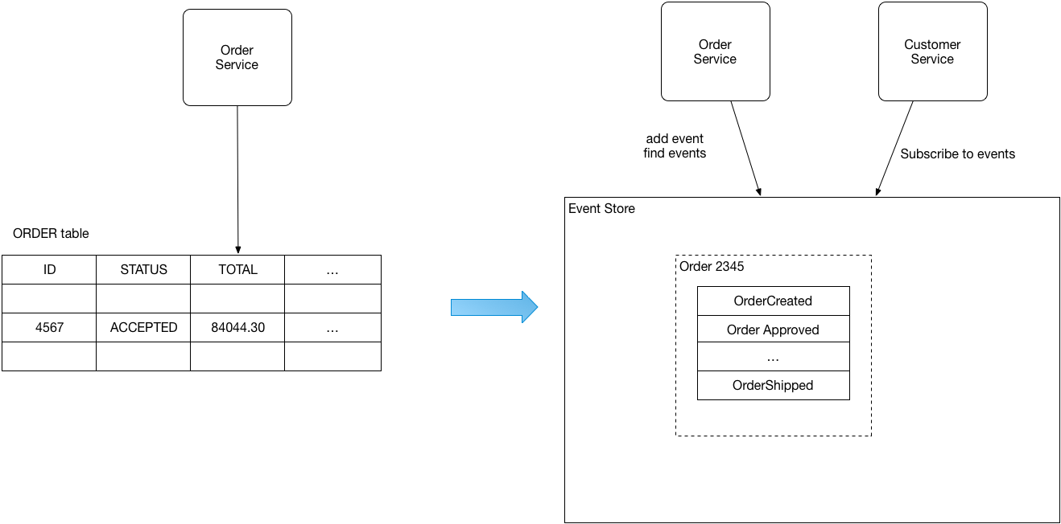
Event Sourcing Example

Slide 4
Aggregate
“An aggregate is an entity or group of entities that is always kept in consistent state (within a single ACID transaction).
The Aggregate Root is the entity within the aggregate that is responsible for maintaining this consistent state.
This makes the aggregate the prime building block for implementing a command model in any CQRS base application.”

Slide 5
CQRS
CQRS is a software design pattern that stands for Command Query Responsibility Segregation.
CQRS suggests that applications should be divided in a command and a query part.
Commands alters the state of an object or entity, and queries return the state of an object or entity.

Slide 6
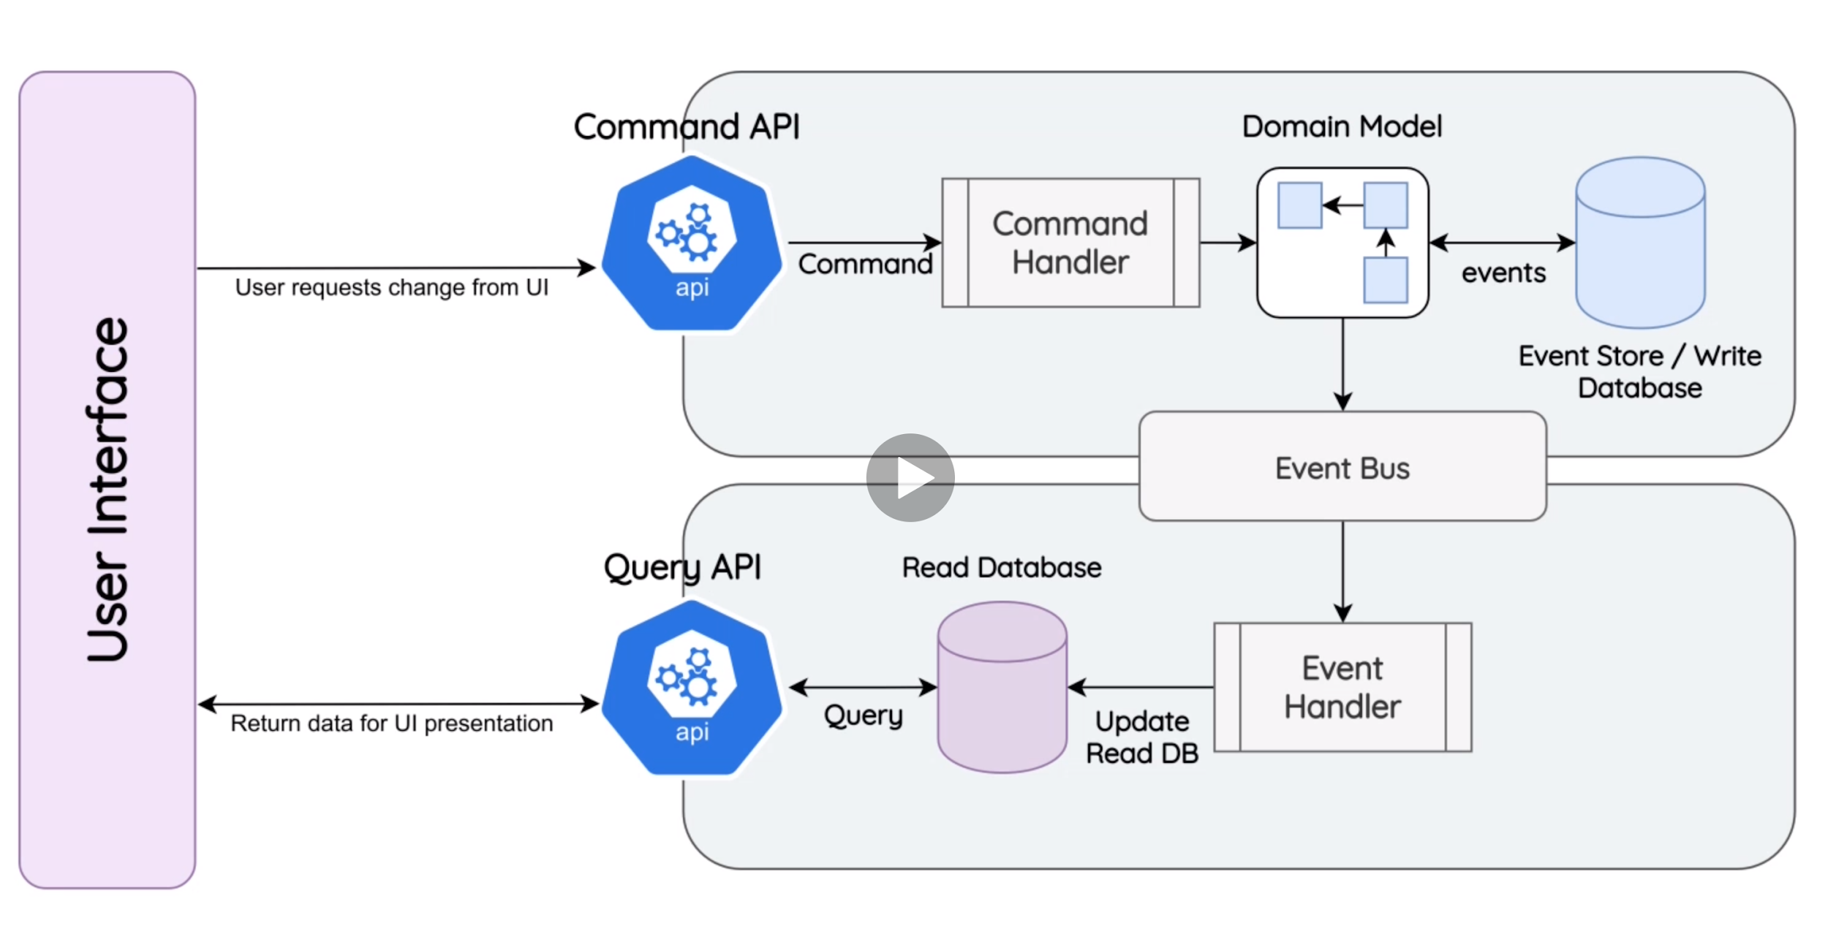
CQRS Schema

Slide 7
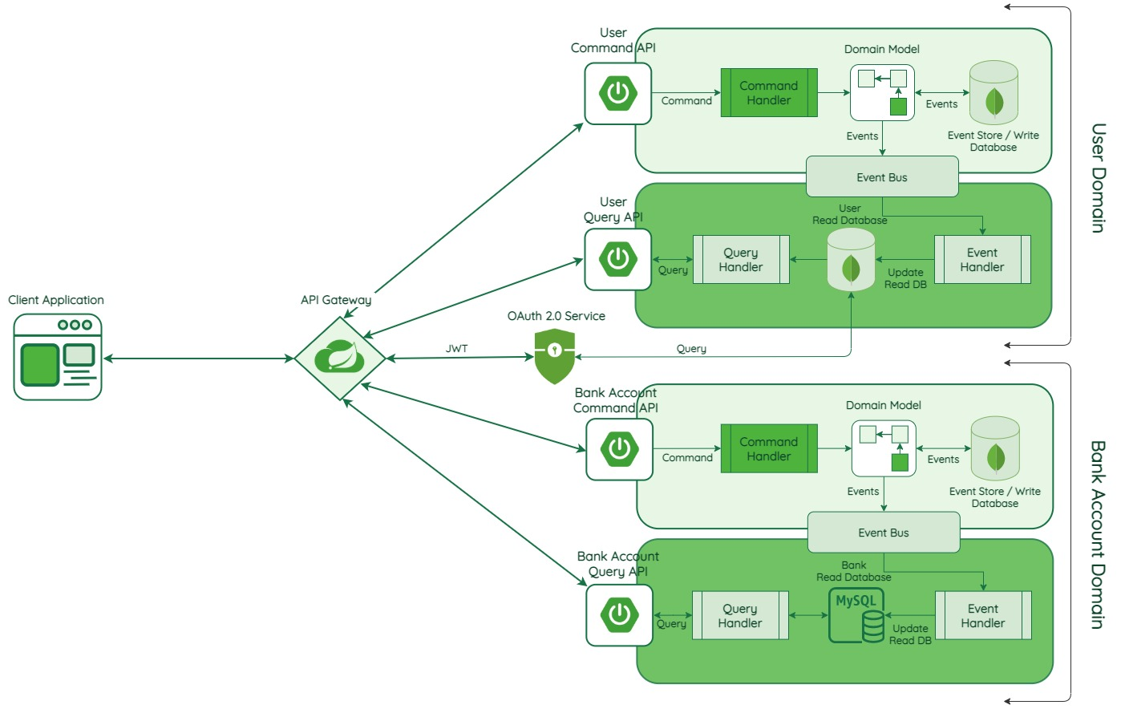
Example Application

